Slide 1
Matlab code for Starters
CSE-AI First year ‘Coding Bootcamp’

Slide 2
%Program 1
%Add 1 to 100
sum=0;
for i=1:1:100
sum=sum+i;
end
sum
%Program 2
%Add 1 to 100 odd numbers
sum=0;
for i=1:2:100
sum=sum+i;
end
sum
%Program 3
%Add 1 to 100 even numbers
sum=0;
for i=2:2:100
sum=sum+i;
end
sum
2550
5050
2500

Slide 3
Use of Break
%Program 4
%find cumulative sum starting from 1. If sum exceed 2560 break and print index i
sum=0;
Limit=2560;
for i=1:1:100
sum=sum+i;
if (sum>=Limit) break; end
end
display(i) ; display(sum)
Do check whether it is true
If (true) break out of the loop

Slide 4
If any of several statements is true
Do this
else
Do this
end

Slide 5
Collect all the true/false in a vector
Apply any to that vector
-call ‘any’ function with the vector as input

Slide 6
% Program 5
clear all
% get all prime numbers between 1 to 100
X=[2 3 5 7]; % prime numbers between 1 and sqrt(100)
% compo=[];
for i=8:100
if any( [mod(i,2)==0 mod(i,3)==0 mod(i,5)==0 mod(i,7)==0])
% compo=[compo i];
else X=[X i] ; % append
end
end
X
Challenge: How will you extend to 1000
2 3 5 7 11 13 17 19 23
29 31 37 41 43 47 53 59 61
67 71 73 79 83 89 97

Slide 7
% Program 6
% find number of numbers divisible by 3 or 5 in 1:100
clear all
X=[];
for i=1:1:100
if any([mod(i,3)==0, mod(i,5)==0])
X=[X i];
end
end
n=length(X)
n=47

Slide 8
% Program 7
% Find standard deviation of all numbers in 1:100 range
clear all
x=1:1:100; % data in an array x
n=length(x);
Sumx=0; Sumx2=0;
for i=1:1:n
Sumx=Sumx+x(i);
Sumx2=Sumx2 + x(i)*x(i);
end
Variance=Sumx2/n-(Sumx/n)^2
Stdev=sqrt(Variance)
% use built in function
Stdev2=std(x,1)
Population standard deviation
Variance = 833.2500
Stdev = 28.8661
Stdev2 = 28.8661

Slide 9
% Program 8
% Find first 20 fibonacci numbers
clear all
x(1)=1;
x(2)=1;
for i=3:1:20
x(i)=x(i-2)+x(i-1);
end
x

Slide 10
% Program 9
% Find first n factorial starting from 1
clear all
x(1)=1;
for i=2:1:10
x(i)=x(i-1)*i;
end
x

Slide 11
Program 10
1D automata
First column and last column values are
assumed to be zeros

Slide 12
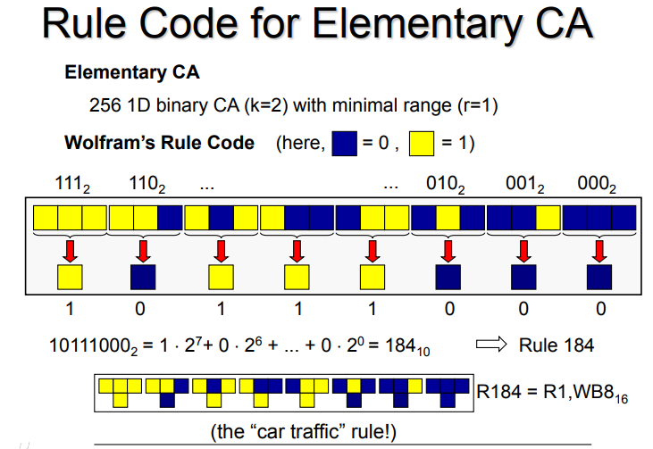
Only 8 neighbourhood
configuration
3 bit to 1 bit mapping
Can be represented by
Binary digits of a number between 1 and
255

Slide 13
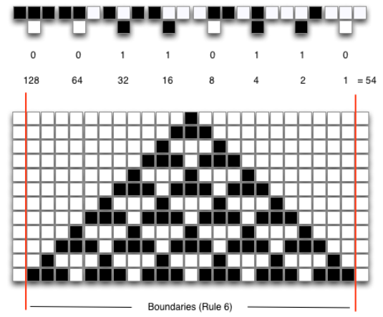
7
6
5
4
3
2
1
0
White→0
Black→1
111
101
100
000
54₂=00110110
Wolfram Rule No: 54

Slide 14
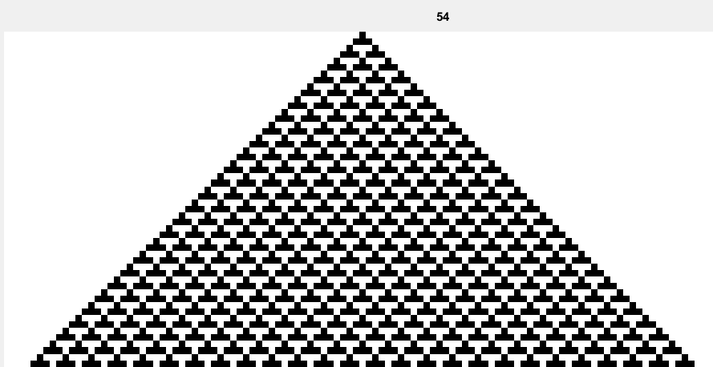

Slide 15
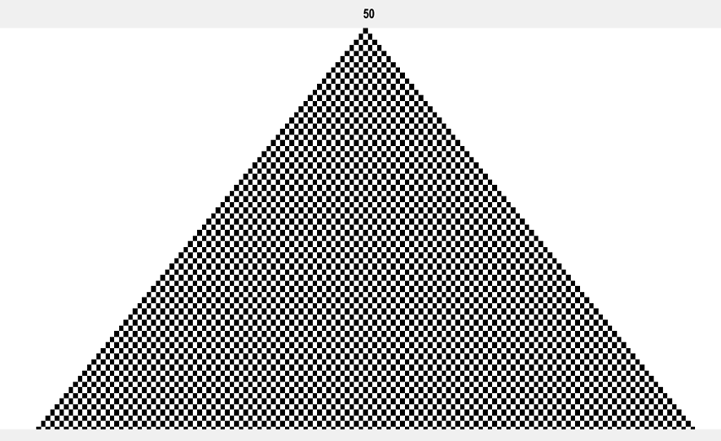
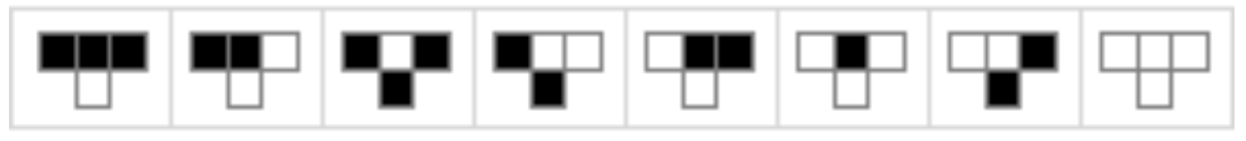
Rule 50

Slide 16
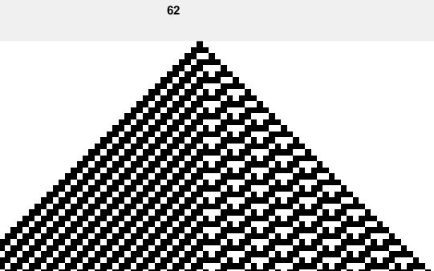

Slide 17
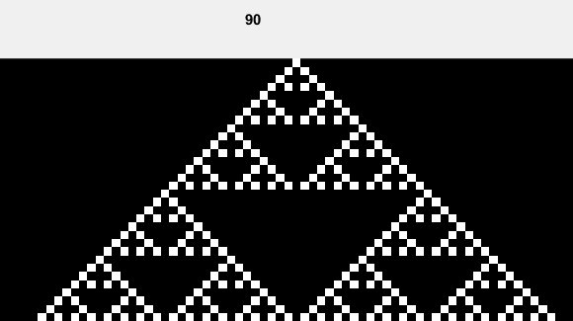
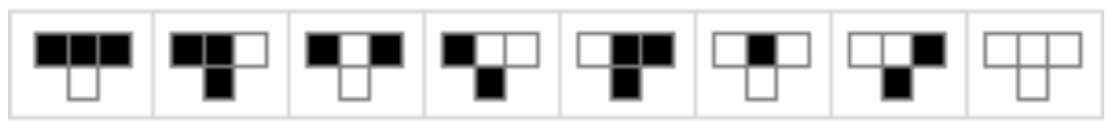

Slide 18
wolfrule=30;
'00011110’=0+0+0+16+8+4+2+0=30
(111)
(011)
rule = '00011110'
(111)
7 6 5 4 3 2 1 0
ru = 0 0 0 1 1 1 1 0
for i=1:8 ru(i)=str2num(rule(i))
end
runo = 1 2 3 4 5 6 7 8
1 1 1 is mapped to 0
1 1 0 is mapped to 0
1 0 1 is mapped to 0
1 0 0 is mapped to 1
0 1 1 is mapped to 1
6. 0 1 0 is mapped to 1
7. 0 0 1 is mapped to 1
8. 0 0 0 is mapped to 0
Rule interpretation

Slide 19
wolfrule=30;
rule=dec2bin(wolfrule,8);
for i=1:8
ru(i)=str2num(rule(i));
end
nrows=350; ncols=700; A=zeros(nrows, ncols);
A(1,350)=1;
for i=2:nrows
for j=2:ncols-1
l=A(i-1,j-1); m=A(i-1,j); r=A(i-1,j+1);
if(( l & m & r & ru(1)) | ...
( l & m &~r & ru(2)) | ...
( l &~m & r & ru(3)) | ...
( l &~m &~r & ru(4)) | ...
(~l & m & r & ru(5)) | ...
(~l & m &~r & ru(6)) | ...
(~l &~m & r & ru(7)) | ...
(~l &~m &~r & ru(8)) )
A(i,j)=1;
end
end
end
I=mat2gray(A);
figure
imshow(I)
axis image; title(wolfrule);
I=mat2gray(2-A);
figure
imshow(I)
axis image; title(wolfrule)

Slide 20
if(( l & m & r & ru(1)) | ...
( l & m &~r & ru(2)) | ...
( l &~m & r & ru(3)) | ...
( l &~m &~r & ru(4)) | ...
(~l & m & r & ru(5)) | ...
(~l & m &~r & ru(6)) | ...
(~l &~m & r & ru(7)) | ...
(~l &~m &~r & ru(8)) )
A(i,j)=1;
end
1 1 1 and if ru (1)=1 output =1
1 1 0 and ru (2)=1 output =1
1 0 1 and if ru (3)=1 output =1
1 0 0 and ru (4)=1 output =1
0 1 1 and if ru (5)=1 output =1
0 1 0 and ru (6)=1 output =1
0 0 1 and if ru (7)=1 output =1
0 0 0 and ru (8)=1 output =1
l,m,r

Slide 21
for i=2:nrows
for j=2:ncols-1
l=A(i-1,j-1); m=A(i-1,j); r=A(i-1,j+1);
if(( l & m & r & ru(1)) | ...
( l & m &~r & ru(2)) | ...
( l &~m & r & ru(3)) | ...
( l &~m &~r & ru(4)) | ...
(~l & m & r & ru(5)) | ...
(~l & m &~r & ru(6)) | ...
(~l &~m & r & ru(7)) | ...
(~l &~m &~r & ru(8)) )
A(i,j)=1;
end
end
end

Slide 22
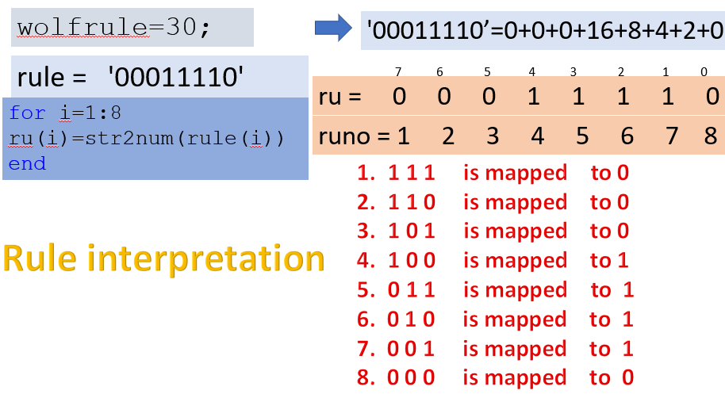
Beauty in the code
A(i-1,j-1)
A(i-1,j)
A(i-1,j+1)
Left, l
middle, m
right, r
A(i,j)
l=A(i-1,j-1); m=A(i-1,j); r=A(i-1,j+1);
if(( l & m & r & ru(1)) | ...
( l & m &~r & ru(2)) | ...
( l &~m & r & ru(3)) | ...
( l &~m &~r & ru(4)) | ...
(~l & m & r & ru(5)) | ...
(~l & m &~r & ru(6)) | ...
(~l &~m & r & ru(7)) | ...
(~l &~m &~r & ru(8)) )
A(i,j)=1;
end
Study how a single if statement with several logical ‘and’ and ‘or’ solves our problem for any rule
If rule number is changes, the mapping will be different. Still
the code works. Learn this thoroughly. In EOC(elements of computing you are learning this)

Slide 23
2D Arrays

Slide 24
nxn Magic square for odd n
Programming to create interesting
Mathematical objects
Programming topics for first year students
Program in Scribble by creating 2D Arrays

Slide 25
Magic squares
row sum= column sum = diagonal sum=15
row sum= column sum = diagonal sum=65
How do we create?.

Slide 26
N=5
Fill in middle cell of the top row.
Move towards right diagonal.
We cross the grid
If we cross top boundary , go down to
the column and fill in next number
1
1
2
Rule 1

Slide 27
Rule 2
1
1
4
3
3
2
2
Move towards right diagonal.
It is unfilled . Fill it with 3
Move towards right diagonal.
Boundary crossed. Go to left most cell

Slide 28
Already Filled
Retrace and go down by one cell
1
1
5
5
4
4
6
3
3
2
2
Rule 3

Slide 29
1
1
8
5
7
5
7
4
6
4
6
3
3
2
2

Slide 30
1
8
1
8
5
7
5
7
4
6
4
6
3
10
3
2
9
2
9

Slide 31
1
8
1
8
15
5
7
5
7
14
16
4
6
4
6
13
10
3
10
12
3
11
2
9
11
2
9
Rule 3
Rule 4
Special rule for right top corner cell

Slide 32
17
1
8
15
17
1
8
15
5
7
14
16
5
7
14
16
4
6
13
4
6
13
20
10
12
3
10
12
19
3
11
18
2
9
11
18
2
9

Slide 33
17
1
8
15
17
1
8
15
5
7
14
16
5
7
14
16
4
6
13
20
4
6
13
20
22
10
12
19
21
3
10
12
19
21
3
11
18
2
9
11
18
2
9
Rule 3

Slide 34
17
24
1
8
15
23
5
7
14
16
4
6
13
20
22
10
12
19
21
3
11
18
25
2
9

Slide 35
clear all
% Fill in a odd magic squre from 1 to N^2
% In general numbers must form an Arithmetic %Progression
N=7; % N must be odd
A=zeros(N,N);
j=1+(N-1)/2 ; % fill centre cell in the first row
i=1; A(i,j)=1
for K=2:N*N
i=i-1; j=j+1; % Advance towards right diagonal
% putback into the matrix if gone out
if and(i<1, j==N+1) i=2; j=N; end
if and (j<=N , i<1) i=N; end
if and (i>0 , j>N) j=1; end
if A(i,j)~=0 i=i+2; j=j-1 ; end
A(i,j)=K;
end
A

Slide 36
Investigate
How to create 4x4 magic square
How to create mxm magic square
where m =‘odd number’x2
3. What is determinant of odd magic squares
(in relation to the magic sum and why?.)
4. What is so special about Ramanujan’s 4x4
magic square

Slide 37
Recreational mathematics
Magic Square by Ramanujan

Slide 38

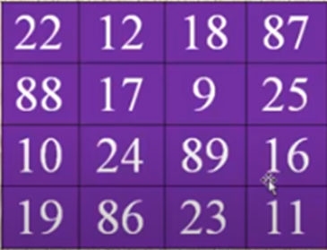

Magic Square by
Srinivasa Ramanujan
22/12/1887 is his date of birth. See the top row
Each column/sum is 139
Both Diagonal sum is 139

Slide 39
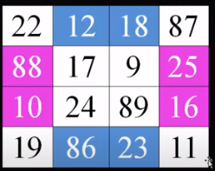
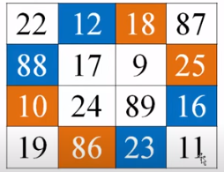
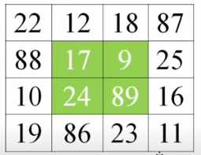
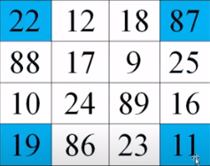
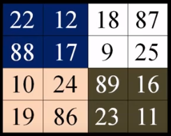
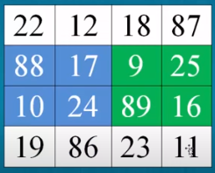
Corner sum is 139
Blue colour number sum is 139
Pink colour number sum is 139
Blue colour sum is 139
Orange colour sum is 139
Pea Green colour sum is 139
Blue colour sum is 139
Dark green colour sum is 139
All same colour sum is 139

Slide 40

Create one each with
Your
Date of birth
How to create. See the next slide

Slide 41
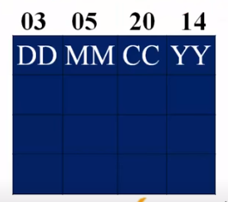
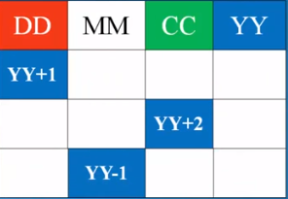
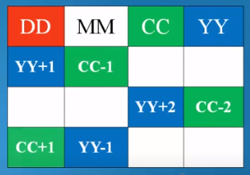
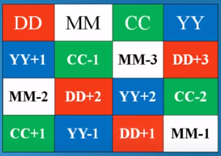
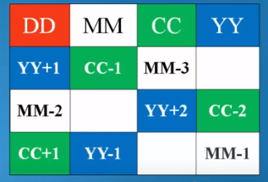

Slide 42
L – System

Slide 43
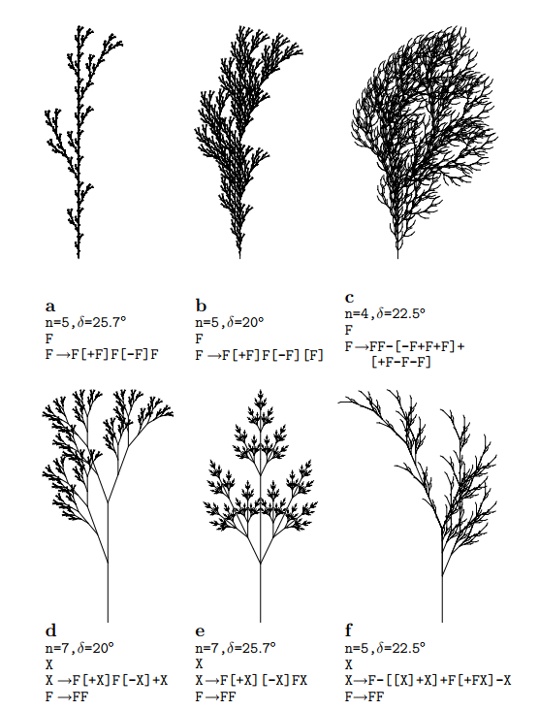
“F” – Move Forward by 1 unit “[“ – Store the current location to the stack “]” – Retrieve the saved location from the stack “n” – Denotes the level / depth of substitution
“+” - Rotate counter clockwise by δ “-” - Rotate clockwise by δ “δ” - Angle of Rotation

Slide 44
“F” or “X” – Move Forward by 1 unit “[“ – Store the current location to the stack “]” – Retrieve the saved location from the stack “n” – Denotes the level / depth of substitution
“+” - Rotate counter clockwise by δ “-” - Rotate clockwise by δ “δ” - Angle of Rotation

Slide 45
Plotting a branching tree in matlab

Slide 46
String to plot: “F[+X][-X]FX”
Interpretation:
F,X → move one step
+ → rotate clock wise by 30 degree
→ rotate anticlock wise by 30 degree
[→ store current state (angle,x,y)
]→ get back the stored state (angle,x,y)

Slide 47
We will use three arrays to store state values
whenever required.
When current command is ‘[‘
index=index+1; % increment index
Store current x,y,angle values using the new index
When current command is ‘]‘
Restore the values at the current index, then update index
index=index-1;
Keep track of ‘index’ to store and restore

Slide 48
We will use line command in MATLAB to plot line segment

Slide 49
Strg='F[+X][-X]FX';
Str1=strrep(Strg,'X',Strg);
Str2=strrep(Str1,'X',Strg);
Str3=strrep(Str2,'X',Strg);
Strc=Str3;
n=length(Strc);
index=0;
% following three arrays are to track branching in the tree
posx(1)=0;
posy(1)=0;
posa(1)=90;
% following variables are for drawing line segment
oldx=0;
oldy=0;
newx=0;
newy=0;
% after plotting a segment, newx and newy become oldx and oldy
cura=90; % Current angle
rota=30;
% on getting a command above will be updated
Turtle
stack

Slide 50
case '+'
cura=mod(cura+rota,360);
case '-'
cura=mod(cura-rota,360);
case '['
index=index+1;
posx(index)=oldx;
posy(index)=oldy;
posa(index)=cura;
case ']'
oldx= posx(index);
oldy= posy(index);
cura=posa(index);
index=index-1;
end
end
for i=1:n
comd=Strc(i);
switch(comd)
case 'F'
newx=oldx+cos(deg2rad(cura));
newy=oldy+sin(deg2rad(cura));
line([oldx newx],[oldy newy]);
drawnow;
oldx=newx;
oldy=newy;
case 'X'
newx=oldx+cos(deg2rad(cura));
newy=oldy+sin(deg2rad(cura));
line([oldx newx],[oldy newy]);
drawnow;
oldx=newx;
oldy=newy;

